Slide 1

Summary of Papers: Final presentation
By Shrey Gupta

Slide 2
Key Questions
What prior work existed before using smartphone images?
What are the advantages and limitations of using smartphone images over PPG signals?
What prior work exists using smartphone images?
Which body location is best for determining pallor via smartphone image?
What is the dataset comprised of?

Slide 3
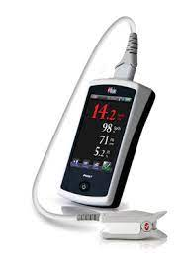
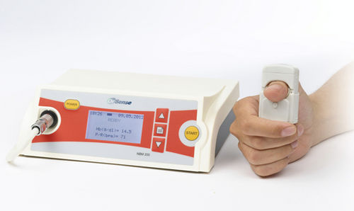
Answers to Key Questions
1. What prior work existed before using smartphone images?
Before 2019 most of the research was focused on using Photoplethysmogram (PPG) signals to non-invasively measure the haemoglobin concentration. Devices such as Pronto-7, Haemospect, NBM-200 and Pulse Oximeter were used to determine the haemoglobin levels in the blood.
Researchers were trying to validate these applications in various medical cases while others were focused on using machine learning models to determine the haemoglobin from these PPG signals.
Advantages:
Non-invasive
Real-time monitoring
Cost-effective
Limitations:
Indirect measurement
Accuracy and precision
Interference
NBM-200
https://www.ncbi.nlm.nih.gov/pmc/articles/PMC8875318/
Pronto-7
Notes:
Advantages:
Non-invasive: PPG can be measured using wearable devices, making it more convenient and comfortable for patients.
Real-time monitoring: PPG provides continuous, real-time data, allowing for dynamic monitoring of hemoglobin levels.
Cost-effective: PPG devices are generally more affordable compared to medical imaging equipment
Limitations:
Indirect measurement: PPG signals provide an indirect estimation of hemoglobin levels based on changes in blood volume.
Accuracy and precision: The accuracy and precision of PPG-based hemoglobin estimation may not be as high as traditional laboratory methods, such as blood tests..
Interference: PPG signals are sensitive to motion artifacts and external light sources

Slide 4
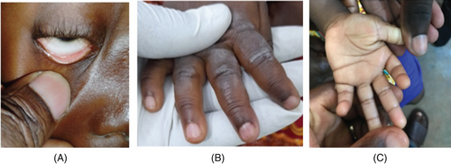
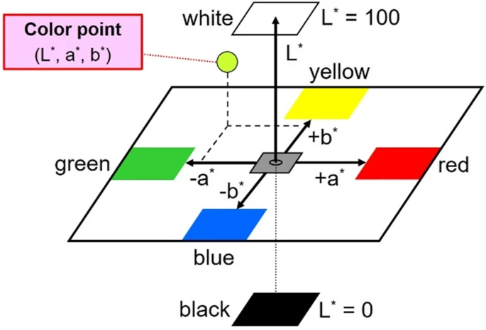
Answers to Key Questions
2. What are the advantages & limitations of using smartphone images over PPG signals?
Advantages
Color information
Ease of integration with existing technology
Potential for remote assessment
Non-contact or minimally invasive
Limitations
Camera quality
Lighting Condition
https://biodatamining.biomedcentral.com/articles/10.1186/s13040-023-00319-z#Tab6
https://onlinelibrary.wiley.com/doi/full/10.1002/eng2.12667
Notes:
Color information: Hemoglobin carries oxygen, which affects the color of blood. Images can capture these color variations, and certain imaging techniques like hyperspectral imaging can even quantify hemoglobin levels based on spectral analysis of the captured colors.
Ease of integration with existing technology: Many medical facilities already have imaging equipment, such as cameras or smartphones, which can be readily used for capturing images, making it a cost-effective option.
Objective and standardized analysis: Advanced imaging techniques can allow for objective and standardized analysis of hemoglobin levels, reducing inter-operator variability often seen in manual PPG signal analysis.
Potential for remote assessment: Images can be captured and transmitted remotely, allowing healthcare professionals to assess patients' conditions in telemedicine or remote healthcare setups.
Non-contact or minimally invasive: Some imaging techniques are non-contact or minimally invasive, minimizing patient discomfort and risk of infection

Slide 5
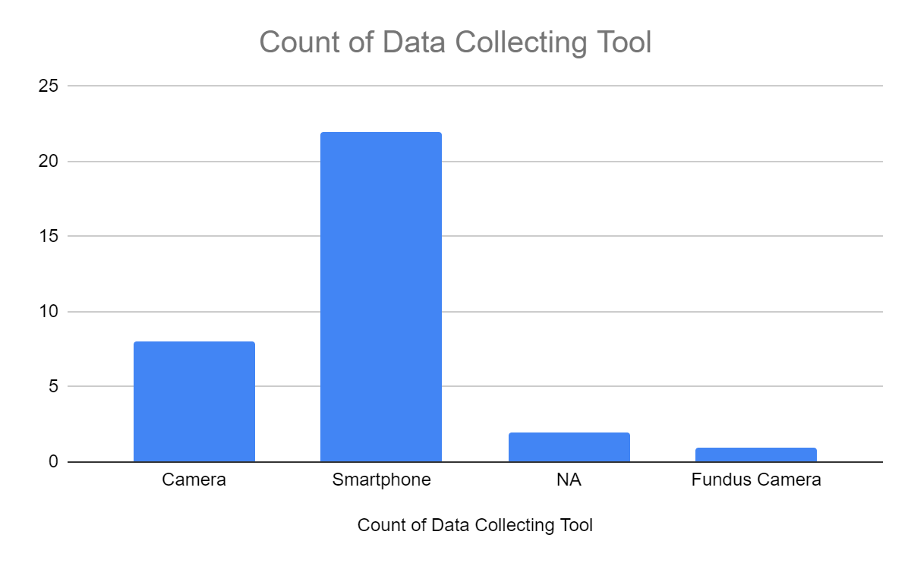
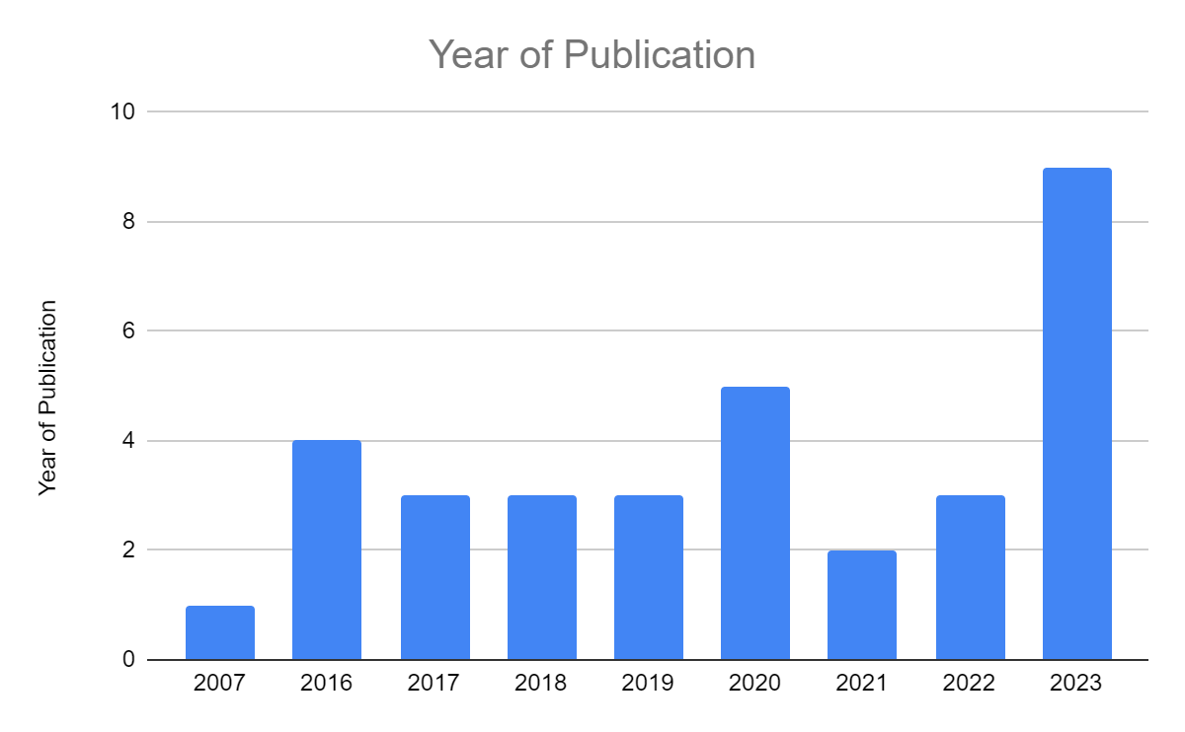
Answers to Key Questions
3. What prior work exists using smartphone images?
After 2019 most of research saw a shift towards using smartphone\digital camera and images of anatomic parts such as palm, conjunctiva, fingernail bed and tongue to determine the hemoglobin level. These anatomic parts contains few melanin-producing skin cells and there is a correlation between the degree of paleness of these parts and the hemoglobin content
Notes:
Researchers have widely used conjunctiva images for hemoglobin estimation due to its rich vascularization and the fact that pale conjunctiva is most common symptoms of anemia
Coming to machine learning algorithms, there a wide range of machine learning algorithms being used starting from regression to neural networks or decision trees.

Slide 6
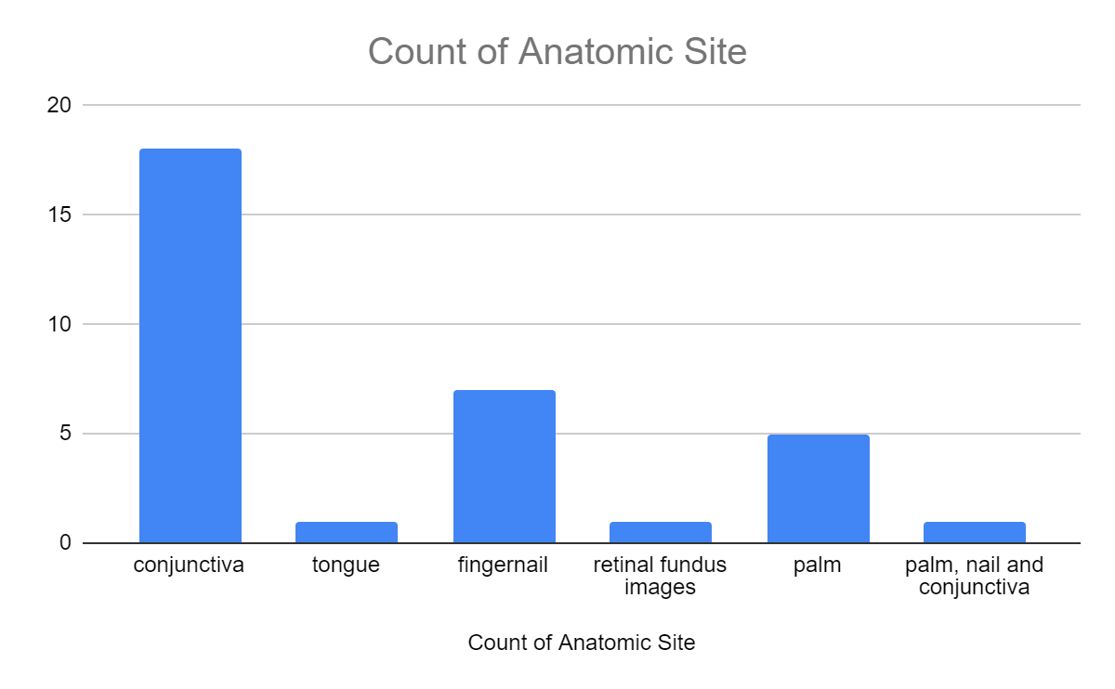
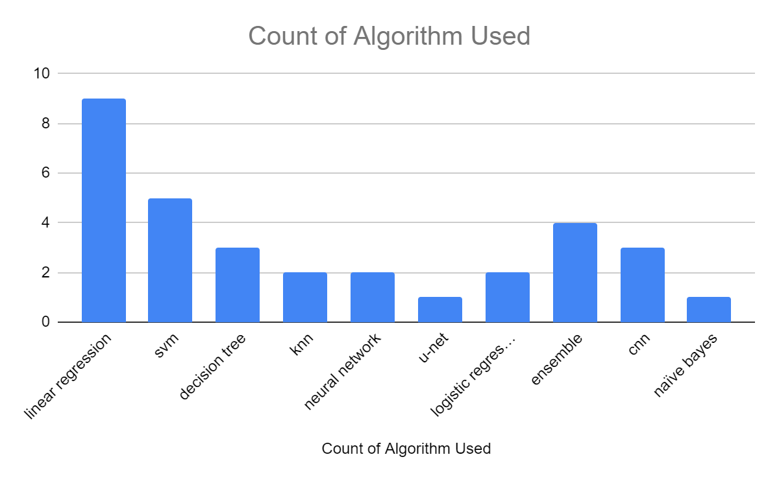
Answers to Key Questions
4. Which body location is best for determining pallor via smartphone image?

Slide 7
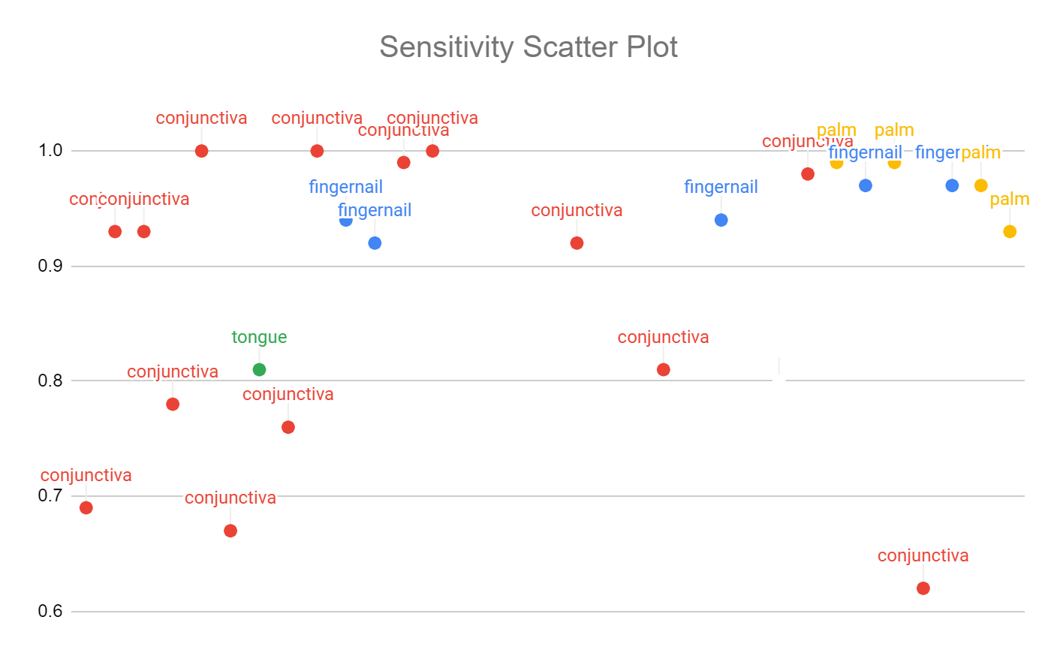
Answers to Key Questions
4. Which body location is best for determining pallor via smartphone image?
Anatomic Site | COUNTA of Anatomic Site
conjunctiva | 18
fingernail | 7
palm | 5
tongue | 1
Grand Total | 31

Slide 8
Answers to Key Questions
5. What is the dataset comprised of?
The minimum number of people used of the dataset is 41, while the maximum is close to 57K
The average number of people (excluding the outlier) is approximately 200
The average number of images per person is 1 when considering each anatomic part separately
In most of the dataset the percentage of women is more than men
Smartphone images has been widely used for capturing the images, while some of the researches used camera or some device connected to the smartphone
Though the researches span all age groups, the majority of the people in the dataset were in the range of 25 - 45 years

Slide 9
Summary
Title of Paper | Author | Year of Publication | Algorithm Used | Accuracy | Sensitivity | Precision / Specificity
Smartphone app for non-invasive detection of anemia using only patient-sourced photos | Robert G. Mannino et al^{[1]} | 2018 | linear regression | NA | 0.92 | 0.76 (S)
Prediction of anemia and estimation of hemoglobin concentration using a smartphone camera | Selim Suner et al^{[2]} | 2021 | linear regression | 0.78 | 0.81 | 0.73 (S)
Iron deficiency anemia detection using machine learning models: A comparative study of fingernails, palm and conjunctiva of the eye images | Justice Williams Asare et al^{[3]} | 2023 | cnn | 0.99 | 0.97 | 0.98 (P)
An intelligent non-invasive system for automated diagnosis of anemia exploiting a novel dataset | Giovanni Dimauro et al^{[4]} | 2023 | svm | 0.86 | 0.64 | 0.91 (S)
Detection of iron deficiency anemia by medical images: a comparative study of machine learning algorithms | Peter Appiahene et al^{[5]} | 2023 | naïve bayes | 0.99 | 0.99 | 0.99 (P)

Slide 10
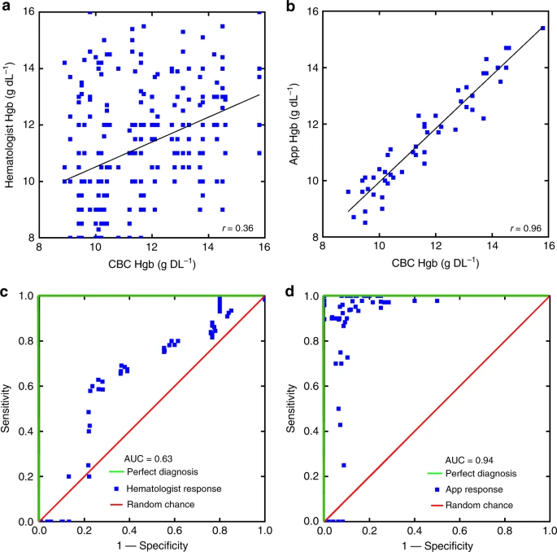
Robert G. Mannino et al [1]
Aim
To demonstrate a system in which accurate Hgb measurements are obtained with a smartphone without the need for any external equipment
Why fingernail?
Fingernails are straightforward for a user to self-image, unlike conjunctiva, and also have low person-to-person size and shape variability, unlike palmar creases
Conclusion
The sensitivity, specificity and AUC was found to be 0.92, 0.76 and 0.88 Note: AUC is the area under the receiver operating characteristic (ROC) curve and ROC is the curve between sensitivity and 1 - specificity at different classification threshold
https://www.nature.com/articles/s41467-018-07262-2#Sec8

Slide 11
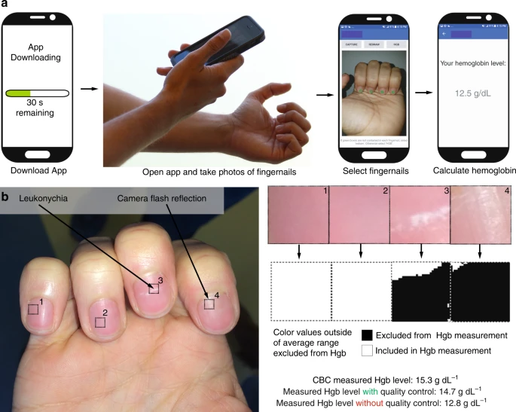
Robert G. Mannino et al [1]
Methodology
A total of 337 fingernail images were taken with 50.4% being male
Region of interest was manually selected from the images from each finger, excluding the thumb
Fingernail data, skin color data, and image metadata were extracted from ROI via MATLAB
Using skin color data and image metadata as parameters a multi-linear regression with a bisquare weighting algorithm was used to relate the image parameter data to CBC Hgb levels for each patient in MATLAB
A 70:30 split was done for training and testing and validation was done by repeating the process a 1000 times with a random split to optimize the parameters of the algorithm
https://www.nature.com/articles/s41467-018-07262-2#Sec8

Slide 12
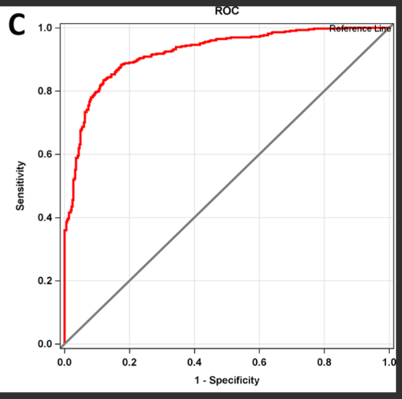
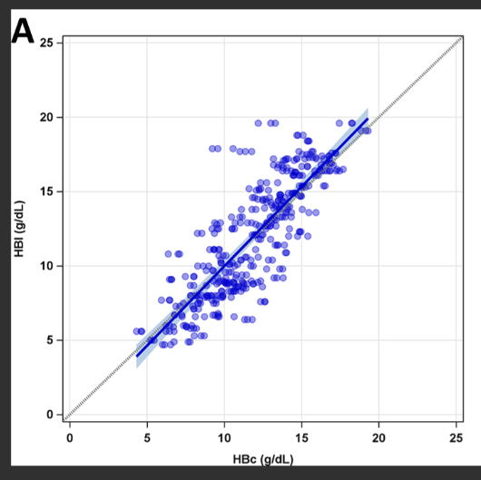
Selim Suner et al [2]
Aim
To develop an algorithm to predict hemoglobin concentration using smartphone captured images of the conjunctiva
Why conjunctiva?
It is a highly vascular surface with minimal connective tissue between the outer mucous membrane and blood vessels.
It lacks melanin, epidermis, dermis, and subcutaneous fat
Conclusion
The HHR (High Hue Ratio) parameter was the primary parameter in the final matrix
Accuracy, Sensitivity and Specificity were 0.78, 0.81 and 0.73 respectively
https://journals.plos.org/plosone/article?id=10.1371/journal.pone.0253495#sec013

Slide 13

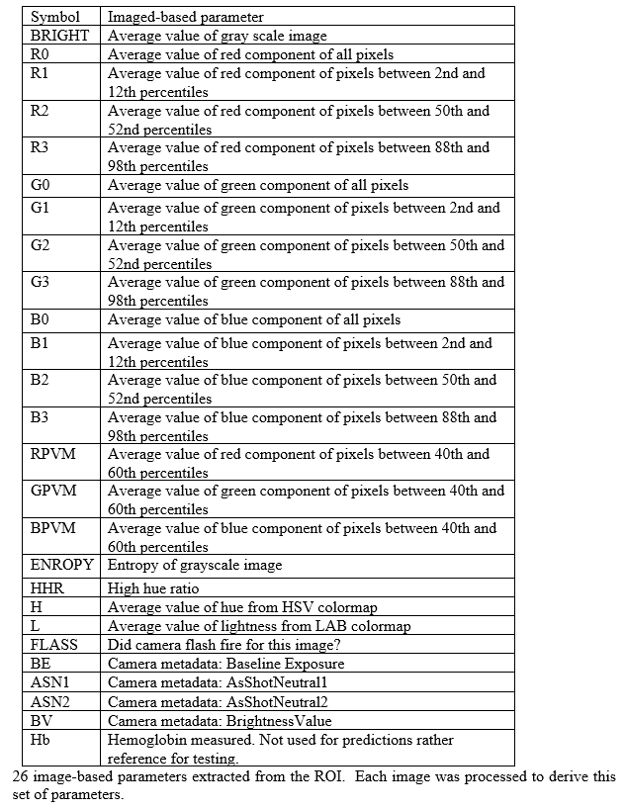
Selim Suner et al [2]
Methodology
Total 344 patients out of which 52% were male
Close to 3K images were captured using an iPhone 7 Plus
Images were analysed using MATLAB, the ROI was selected manually and stored for further use
26 image-based parameters such as average brightness of the image, average value of red image component, flash activation and entropy of the image etc, were extracted from ROI
A matrix with columns as these 26 parameters and the actual Hb values was formed
Regression analysis was performed using this matrix for estimating hemoglobin
During validation k-fold testing was done on 10% of total data for ten times
https://journals.plos.org/plosone/article?id=10.1371/journal.pone.0253495#sec013

Slide 14
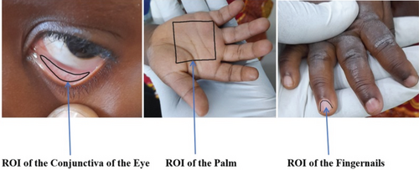
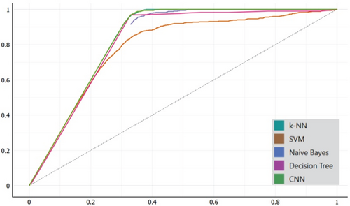
Justice Williams Asare et al [3]
Aim
To do a comparative study of the popular machine learning algorithms like SVM, k-NN, CNN, Naïve Bayes and decision tree for detecting iron-deficiency anemia using images of the conjunctiva of the eyes, palpable palm and color of the fingernails
Conclusion
The CNN obtained an accuracy of 98.45% on the conjunctiva of the eyes, 98.33% on the color of the fingernails, and 99.12% on the palpable palm
The best detection result was obtained by combining three component features a*, b*, and the G value retrieved from the RGB component pictures.
AUC curve of the conjunctiva of the eyes for anemia detection
https://onlinelibrary.wiley.com/doi/full/10.1002/eng2.12667

Slide 15
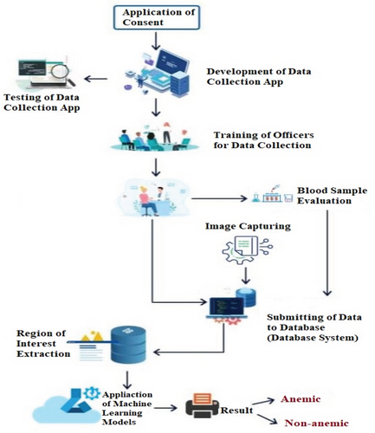
Justice Williams Asare et al [3]
Methodology
The data was collected using Kobo Collect (v2021.2.4) installed on Samsung Galaxy Tab 7A
Images of conjunctiva, palm and fingernails were taken from 710 children aged 6 to 59 months
To extract the conjunctiva from the eye image, triangle thresholding was applied
Then all the images were segmented into their various CIE L*a*b* color spaces
Then for each image of the dataset augmenting such as rotating 90°, and 270°, flipping using the vertical and horizontal method and a translation to the X and Y axis
The final dataset had 2635 images of each conjunctiva, palm and fingernail
The dataset was randomly divided into 70%, 10% and 20%, to train, validated, and tested the models respectively and 10-fold cross-validation was employed for validating the models
CNN was trained using the AlexNet and the stochastic gradient descent (SGD) optimization and ReLu.
https://onlinelibrary.wiley.com/doi/full/10.1002/eng2.12667

Slide 16
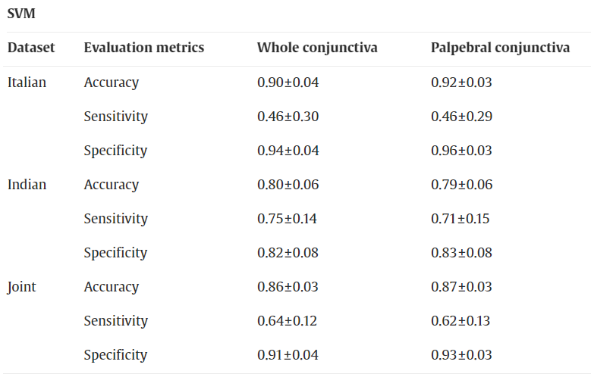
Giovanni Dimauro et al [4]
Aim
To present a novel intelligent system, based on machine learning, that supports the automated diagnosis of anemia
Why conjunctiva?
It has high degree of vascularization and an abundant presence of micro-vessels
Also during the physical examination, heart rate, respiratory rate and pallor conjunctiva or tongue or nail bed are evaluated
Conclusion
SVM had the best accuracy of 0.86 while RUSBoost had the best sensitivity of 0.66
https://www.sciencedirect.com/science/article/pii/S0933365722002299?via%3Dihub

Slide 17
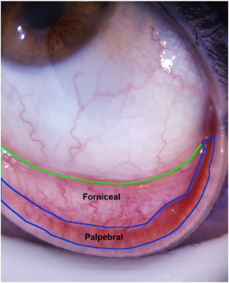
Giovanni Dimauro et al [4]
Methodology
They used the Eye-defy-anemia dataset containing 218 photos of eye which had 40% women
The conjunctiva was either automatically segmented or manually segmented by experts
Eleven features are extracted: mean_{R}, mean_{G}, mean_{B}, HHR, Ent, B, g₁, g₂, g₃, g₄, and g₅
All the pixels whose components in the RGB color space were less than or equal to 20 and greater than or equal to 240 were not considered
The dataset was randomly split for training (70 %) and testing (30 %), while preserving the proportion of anemic and non-anemic patients
To address the class-imbalance of the dataset RUSBoost algorithm was used.
The RUS algorithm helps balance the class distribution, and the AdaBoost algorithm improves the performance of the base learner using balanced data
https://www.sciencedirect.com/science/article/pii/S0933365722002299?via%3Dihub

Slide 18
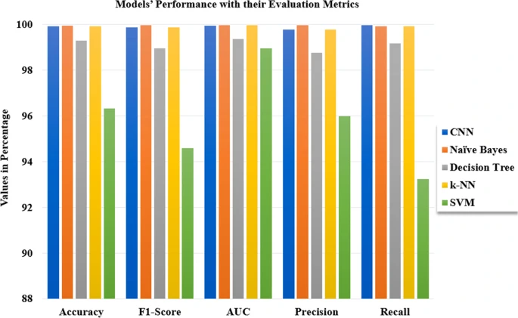
Peter Appiahene et al [5]
Aim
Using the pallor of the palm to detect anemia using machine learning algorithms through a comparative study of Decision Tree, SVM, Naïve Bayes, k-NN and CNN
Why palm?
The Integrated Management of Childhood Illness (IMCI) strategy developed by the World Health Organization recommends the use of palmar pallor as the initial screening tool for anemia
Conclusion
The Naïve Bayes attained the highest accuracy of 99.96% while CNN had the highest sensitivity of 99.98%
https://biodatamining.biomedcentral.com/articles/10.1186/s13040-023-00319-z#Tab6

Slide 19
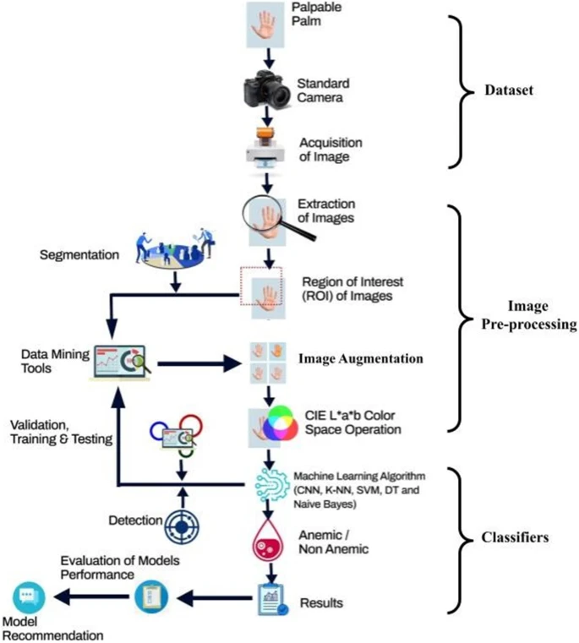
Peter Appiahene et al [5]
Methodology
Data was collected using the Kobo and ODK Collect apps for 527 patients with 57% being female
The triangle thresholding approach was used to extract the features images to generate the ROI
Then all the images were segmented into their various CIE L*a*b* color spaces
Then for each image of the dataset augmenting such as rotating 90°, and 270°, flipping using the vertical and horizontal method and a translation to the X and Y axis
Final dataset has 2635 palm images and 70:10:20 split with a 10-fold cross-validation was done
https://biodatamining.biomedcentral.com/articles/10.1186/s13040-023-00319-z#Tab6

Slide 20
Summary
Dataset Collection
Use conjunctiva and nail images for final model
ROI Extraction
To extract the conjunctiva from eye image use a deep neural network structure
To extract ROI from nail images either do manual extraction or again use a deep neural network
Feature Extraction and Data Processing
After all ROI’s are extracted, extract the features from the images and make the matrix of features which includes the haemoglobin values and the classes (anemic, non-anemic, etc.) and gender
Perform EDA on matrix of features to determine the possible algorithms to use
Perform data augmentation to increase the data and make model robust to orientation of images P.S. - keep the target values same after augmentation
Add all the images to make the final dataset and extract the features to make the final matrix
Modeling
Divide the final matrix into training, validation and testing
Train different models to find the “best model”
Then find the “right hyperparameters” to the “best model”

Slide 21
THANK YOU

